Slide 1
Practice Questions

Slide 2
Instructions
There could be multiple ways to solve the same task, but all the questions in this list can be solved using the concepts discussed till last session. So kindly stick to those

Slide 3

Task 1
Considering only sales (that is, not considering returns or negative sales), find the lowest and highest sale amount that happened between 14th January and 8th April 2020.

Slide 4

Task 2
Find the first and last date on which a sale happened.

Slide 5

Task 3
Find the first date that a transaction took place in the month of April

Slide 6
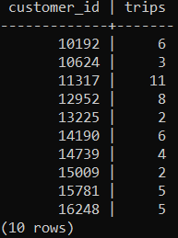
Task 4
For each customer, calculate the number of dates he made a trip to the store.

Slide 7

Task 5
What is wrong with the following query?

Slide 8

Task 6
What is wrong with the following query?

Slide 9

Task 7
Find the sum of sale amount, the average of sale amount, the max sale amount and the min sale amount for all transactions that took place in the month of March

Slide 10
Task 8
Find unique list of first name and last names of customers.
Can you think of another way of solving same question?

Slide 11

Task 9
How many vendors are there who have a last name?

Slide 12
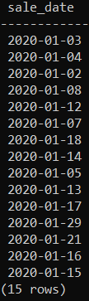
Task 10
Find the unique dates on which a transaction/sale occurred in January, but you can’t use DISTINCT keyword

Slide 13
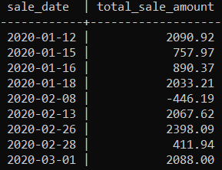
Task 11
Find the total sale amount on each day a transaction was made but consider only those dates where more than one customer made a purchase.

Slide 14
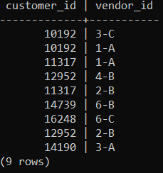
Task 12
Find a list of pair of customer ID and vendor ID where a customer has been billed by same vendor more than once.

Slide 15
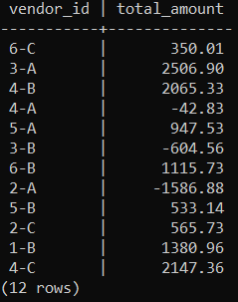
Task 13
Get the total sale amount that each vendor has been independently responsible for, but only considering those vendors whose first transaction was after 1st Feb 2020.

